Slide 1
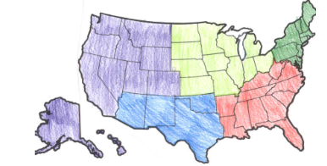
Regions of the United States

Slide 2
Regions
There are 5 Regions that make up the U.S.
Northeast
Southeast
Midwest
Southwest
West
States that share similar things are put into regions
Ex: Climate, Economy, Resources, and Land Forms

Slide 3
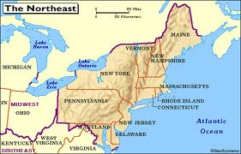
The Northeast
States include:
Connecticut
Maine
Massachusetts
New Hampshire
Rhode Island
Vermont
Delaware
Maryland
New Jersey
New York
Pennsylvania

Slide 4
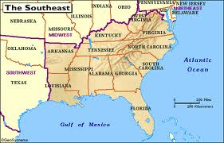
The Southeast
States Include:
Alabama
Arkansas
Florida
Georgia
Kentucky
Louisiana
Mississippi
North Carolina
South Carolina
Tennessee
Virginia
West Virginia

Slide 5
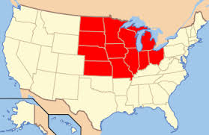
The Midwest
States Include:
Illinois
Indiana
Iowa
Kansas
Michigan
Minnesota
Missouri
Nebraska
North Dakota
South Dakota
Ohio
Wisconsin

Slide 6
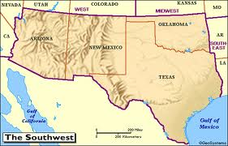
The Southwest
States Include:
Arizona
New Mexico
Oklahoma
Texas

Slide 7
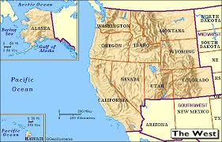
The West
States Include:
Colorado
Idaho
Montana
Nevada
Utah
Wyoming
Alaska
California
Hawaii
Oregon
Washington

