Slide 1
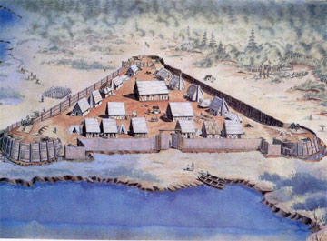
Comparing Jamestown and Plymouth
Early Colonial Settlements

Slide 3
Objective
You will be able to identify how the colonies of Jamestown & Plymouth were similar/different

Slide 4
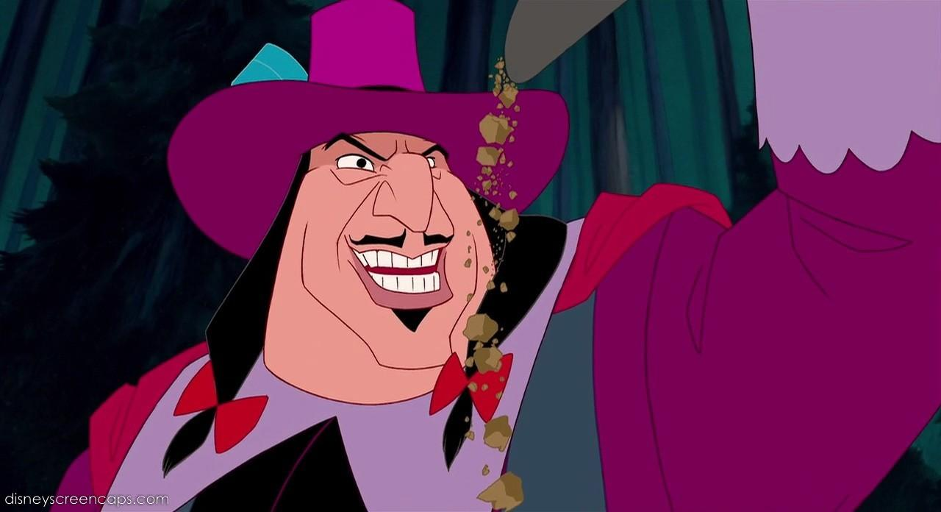
Motivations for Jamestown Colonization
Single men wanted to make money and return to England rich. Did not intend to stay.
Wanted to get there before Spanish and French.
Key Points:
-Looking for GOLD $$
-Did not want to stay
-Wanted to beat the Spanish and French

Slide 5
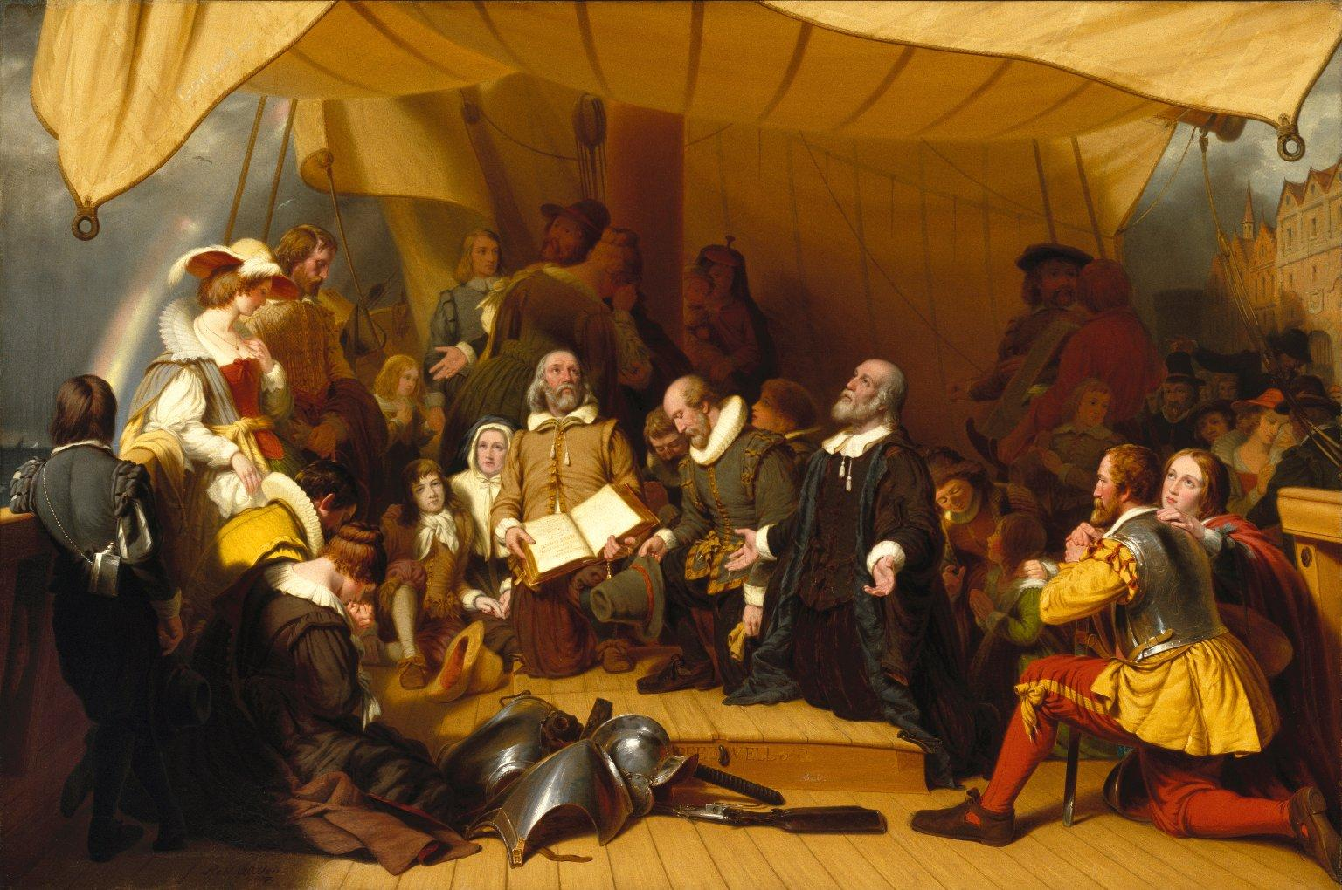
Motivations for Plymouth Colonization
Looking for Religious freedom (for themselves)
Thought the Church of England was too “Catholic”.
Rebelled against Church of England
Key Points:
RELIGIOUS FREEDOM
Pilgrims: “Separate from Church of England”
Puritans: “Purify (reform) Church of England

Slide 6
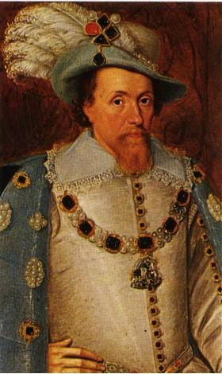
Founding of Jamestown Colony
Founded 1607
Funded by London Joint Stock Company
Charter granted by King James, but NOT funded by King.
Company recruited people with promises that gold could be found by those who made trip
King made decisions on government of colony
Key Points:
Founded: 1607
Funded: Joint Stock Company
Charter: Granted by King James
Promised Gold
King made decisions

Slide 7
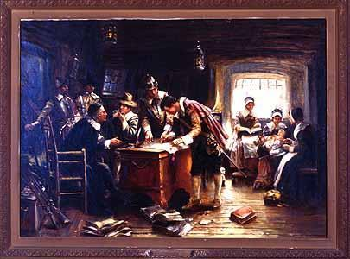
Founding of Plymouth Colony
Founded 1620
Funded by London joint-stock company
Separatists granted land in Virginia, but instead settled in Massachusetts after going off course
Signed Mayflower Compact to provide self-governing guidelines since were not settling in Virginia
Key Points:
Founded: 1620
Funded: Joint Stock Company
Religious Separatists
Signed Mayflower Compact
Subject to King, but governed themselves.

Slide 8
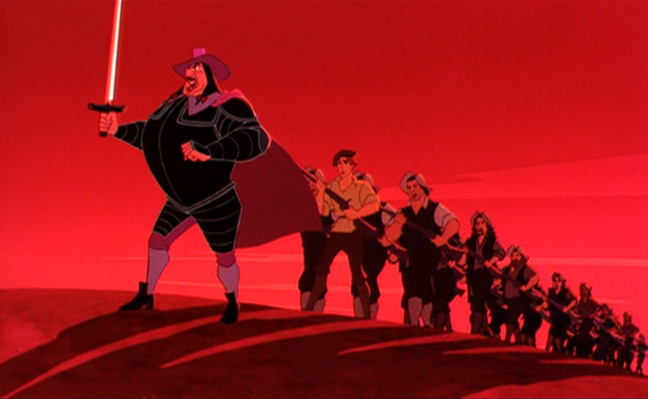
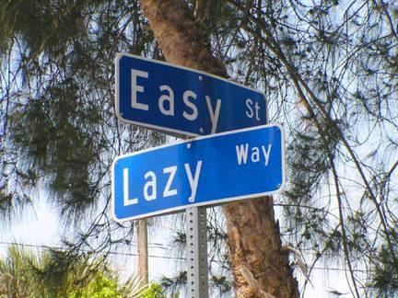
Early Difficulties in Jamestown
Laziness of colonists
There were few expectations that manual labor would be required
Depended on Native Americans for food
Disease and starvation killed a majority of colonists in the first year
Failed attempts to befriend natives led to confrontations
Key Points:
Lazy colonists
Depended on natives for food
Most died in first year
Did not get along with natives

Slide 9
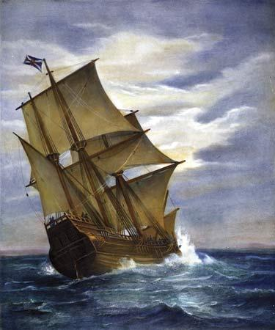
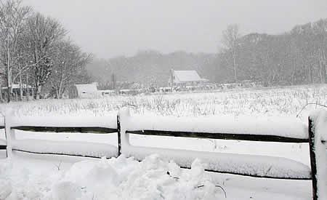
Early Difficulties in Plymouth
Mayflower arrived in Plymouth on Dec. 21
During harsh winter about half died
Early attempts at growing crops failed
Taught how to grow crops by the Natives
Key Points:
Arrived in winter
Half died
Taught to grow food by natives

Slide 10
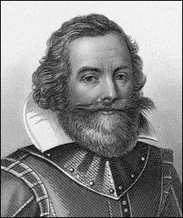
Factors of Success: Jamestown
Captain John Smith takes control of government
“No work, no eat” policy
Firm leadership gives direction during difficult early colonization
Growing tobacco made the land of the colony valuable
Key Points:
John Smith takes control
Found new Cash Crop: Tobacco

Slide 11
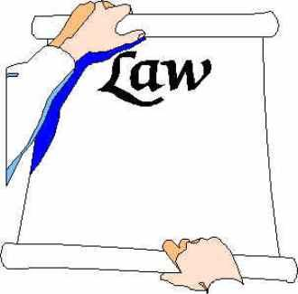
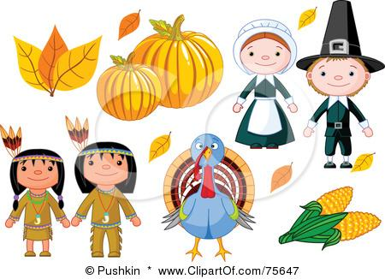
Factors of Success: Plymouth
Strength of Mayflower Compact
Pilgrims able to grow corn (taught from natives)
Initial cooperation of native population and Pilgrims allows for the growth of the colony
Key Points:
Mayflower Compact (self-governance)
Able to grow corn
Initial cooperation with Indians

