Slide 1
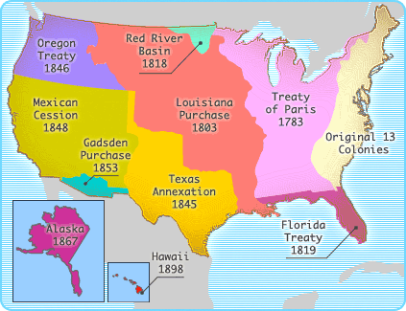
8th Grade American History
Mr. Sprinkle’s Class – Room 417
Wakefield Middle School

Slide 2
Historical Eras We Will Cover (1620-1865)
Pre-Colonial North America
The Colonial Era
The American Revolutionary Era
New Nation and Government
19th Century
Nation Divided & Civil War

Slide 3
Historical Eras We Will Cover (1865-2017)
Reconstruction
Industrialization & Immigration
WWI & the Roaring 20’s
The Great Depression & The New Deal
World War II
The Cold War
Civil Rights
Modern America

Slide 4
About Mr. Sprinkle…

Slide 5
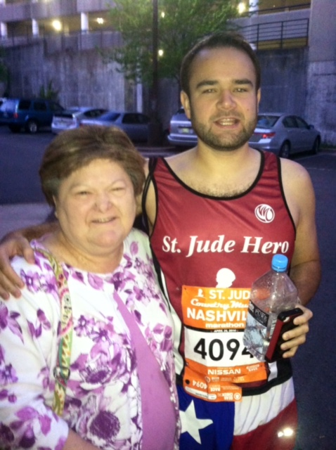
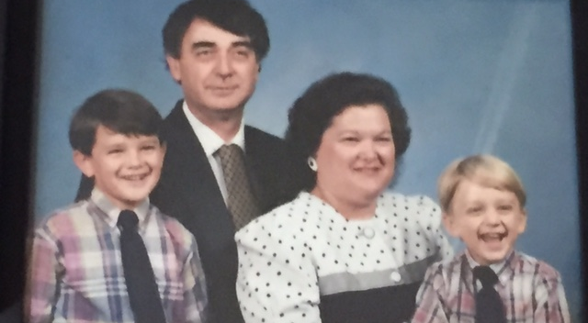
Mi Familia

Slide 6
Post-Secondary Education
Freshmen Year (2004-05)
Bachelor of Arts in Political Science (2008)
Masters of Education (2016)

Slide 7
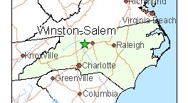
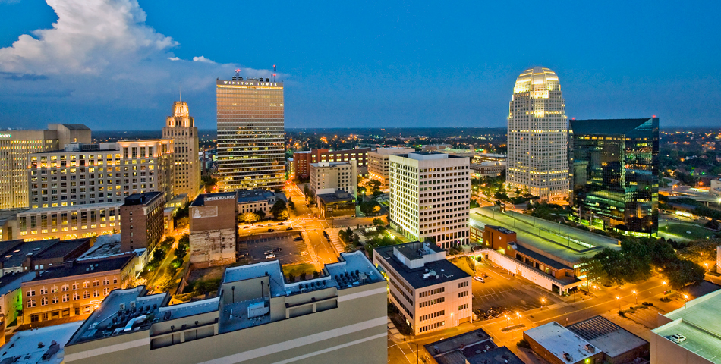
Born & Raised: Winston Salem, NC

Slide 8
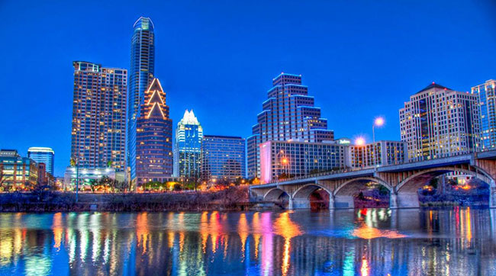
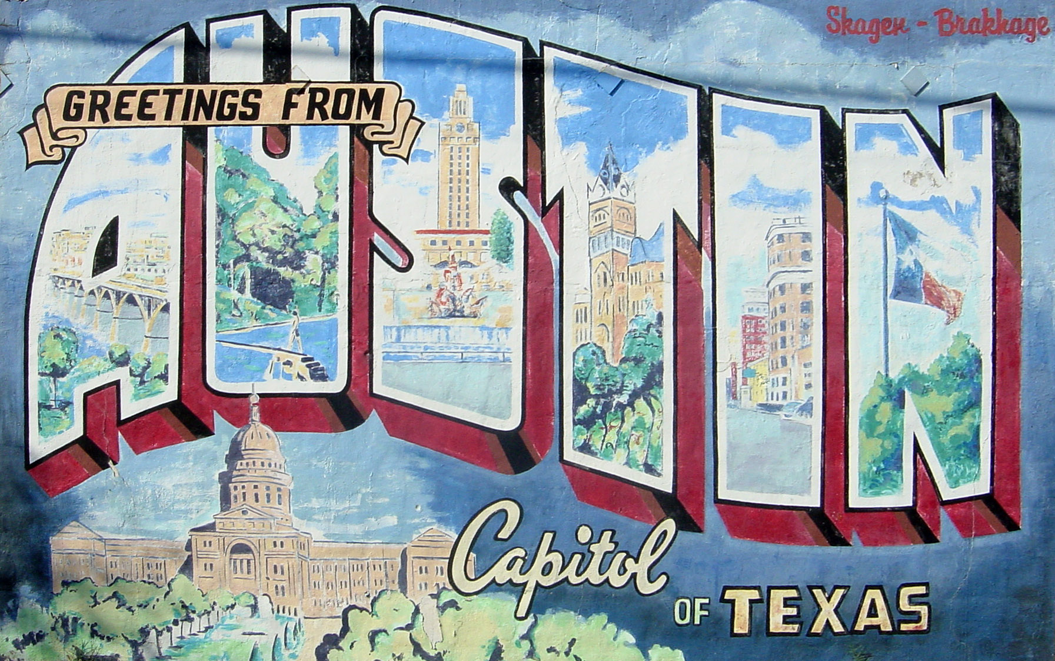
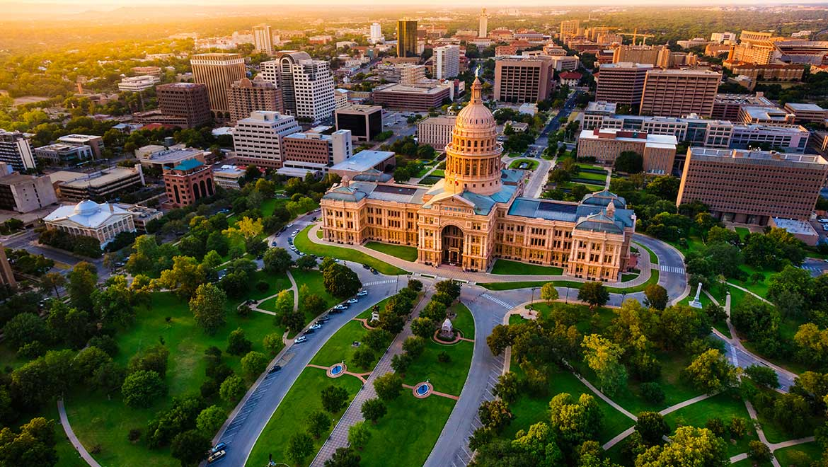
Recent Moved back to NC from: Austin, TX

Slide 9
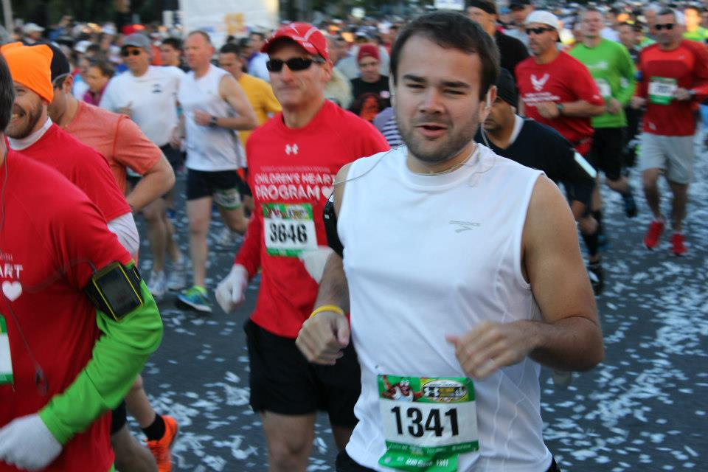
What is my proudest achievement?
Completing my first marathon in Baltimore, MD in 2012!
My finishing time was 3:32:50, which comes out to 8:07/mile, 26.2 times.

Slide 10
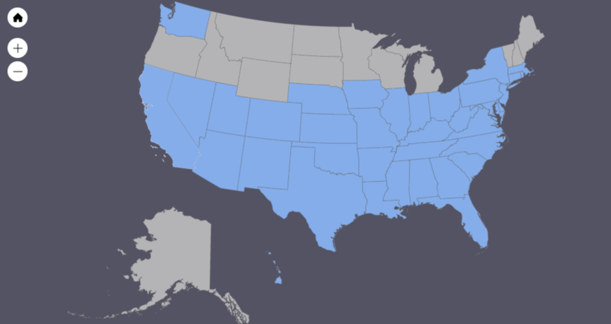
Which states have I visited in the United States?

Slide 11
Non-Educational Interest # 1 - Sports

Slide 12
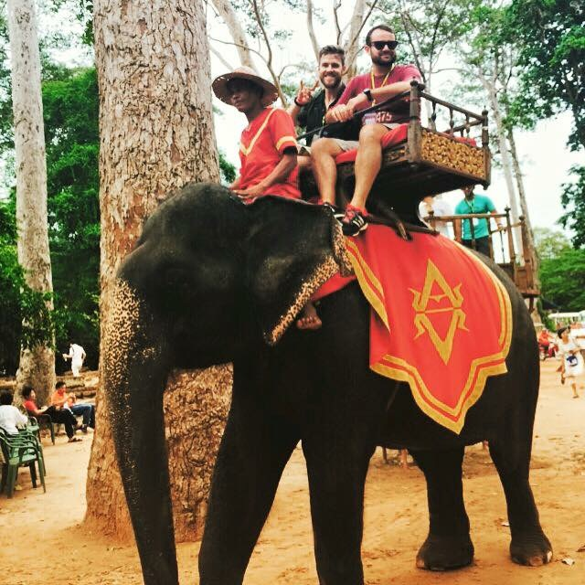
Non-Educational Interest # 2 - Travel

Slide 13
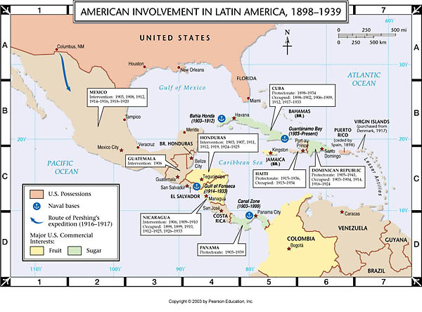
My favorite school assignment
It was a graduate school thesis on revolutions in Latin America and the role that the United States played in creating regime change and destabilization.

Slide 14
U.S. Cities I want to Visit
San Francisco
Portland (Oregon and Maine!)
San Diego
The state of Alaska

