Slide 1
CLASSROOM RULES
Sprinkle
Red Wolves
Social Studies
Wakefield MS
2018-19

Slide 2
OFFENSIVE OR HURTFUL LANGUAGE IS NOT ALLOWED

Slide 3
NO EATING OR DRINKING (except water)

Slide 4
RAISE YOUR HAND TO SPEAK

Slide 5
You Must Ask AND Receive Permission to Leave Your Seat

Slide 6
YOU MUST SHARPEN YOUR PENCIL AT THE BEGINNING OF CLASS

Slide 7
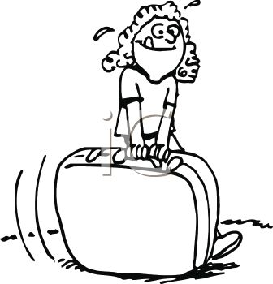
DO NOT PACK UP UNTIL YOU ARE INSTRUCTED TO

Slide 8
Recurring rules breakers will receive an infraction after two warnings. DO NOT be that student.

