Slide 1
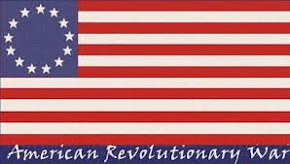
Major Events of the
American Revolution
Lexington & Concord, Trenton, Saratoga, Valley Forge, Yorktown, Treaty of Paris

Slide 2




Continental Army
Commander: Gen. George Washington
Strengths
Highly motivated – fighting for cause
Home field advantage – knew the land
Good leadership from Washington
Foreign aid after 1778
Weaknesses
Not enough men – short enlistments
Poor training – few professional soldiers
Lack of supplies and money
No navy – few privateers vs. world’s best navy

Slide 3
British Army
Commanders: Gens. Howe and Clinton
Strengths
Large army and navy – superpower
Well trained, experienced forces
Plenty of money and supplies
Aided by Loyalists in colonies
Weaknesses
“Away team” – great distance from home
Not familiar with land
Weak leadership – allowed Washington to keep fighting
Lack of motivation at home – Lost support of British people

Slide 4
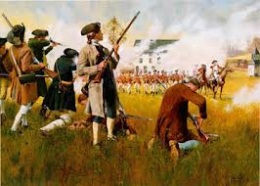
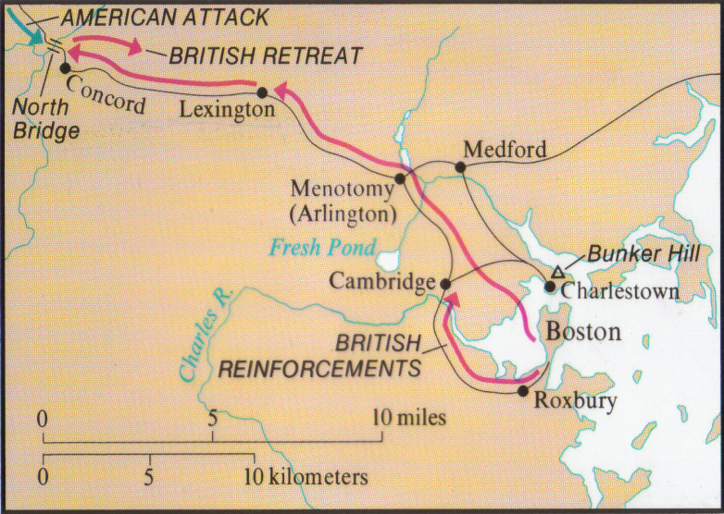

Lexington & Concord
- British troops from Boston sent to capture hidden weapons
- April 19, 1775: met by colonial militia – aka Minutemen - at Lexington, MA – fired the “shot heard ‘round the world”
Marched on to Concord – found few weapons but more militia
Fired on by Minutemen on march back to Boston – heavy casualties

Slide 5

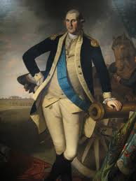

Importance of battle:
First battle of the American Revolution – while not official, war had begun
2nd Continental Congress created Continental Army under General George Washington

Slide 6
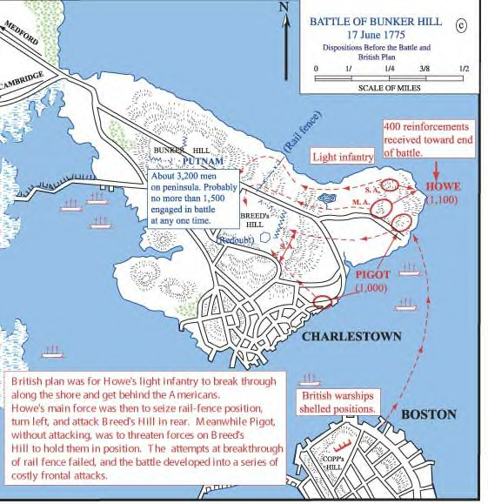
“ Do not fire until you see the whites of their eyes.” Colonel William Prescott
Battle of Bunker Hill (June 17, 1775):
First major battle of the war;
2,200 Redcoats fought to take the heights north of Boston.
Overdressed on a blistering hot day and with the colonists holding the better position on Breed’s Hill, wave after wave of British soldiers attacked and was mowed down.
The British won the battle but it was a costly victory; they suffered 1,054 casualties.
“ Do not fire until you see the whites of their eyes.” Colonel William Prescott – American leader

Slide 7
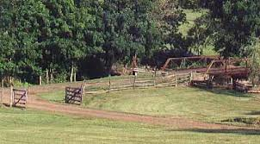
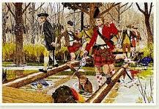
The Battle of
Moore’s Creek Bridge
In the year following the Battle of Bunker Hill, the war spread slowly north and south. Loyalists and Patriots clashed from Maine to Georgia.
February 27, 1776 1st Battle of the American Revolution took place at Moore’s Creek Bridge near Wilmington.
Governor Josiah Martin had a plan to unite NC Loyalist,, with British troops . His plan would restore control of the Southern colonies to British control.
Patriots ambushed the British and Loyalists who were attempting to meet along the banks of Moore’s Creek
50 Loyalists were killed or wounded while the Patriots lost one man.
Called the “Lexington and Concord of the South”
Helped prevent the British from gaining control in the South.

Slide 8
Key People (Part 1)
George Washington – Continental Army commander and general, only successful when fighting unconventionally
Nathaniel Greene – Continental Army general, is successful in defeating British in the South
Horatio Gates – Continental Army general responsible for American victory at Saratoga

Slide 9
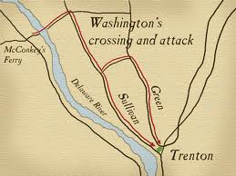
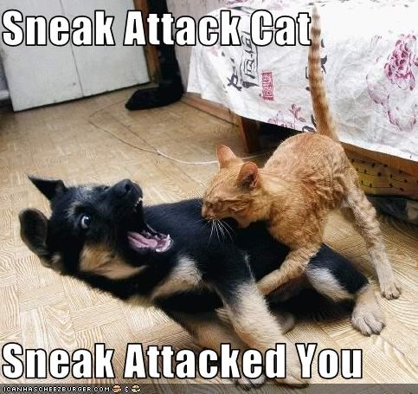
Trenton
After months of defeats, Washington needed to give Americans hope for victory
December 25, 1776: Crossed Delaware River overnight to attack Hessians (hired soldiers) at Trenton, NJ
Surprised Hessians - captured supplies, cannons, and ammo with no casualties
Boosted American morale and army recruitment

Slide 10
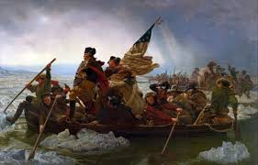
Trenton
Importance of battle:
Gave American cause hope when nearing collapse
Shows American strengths – Washington’s leadership and motivation to fight
Next: The Tide Turns
Washington Crossing the Delaware

Slide 11
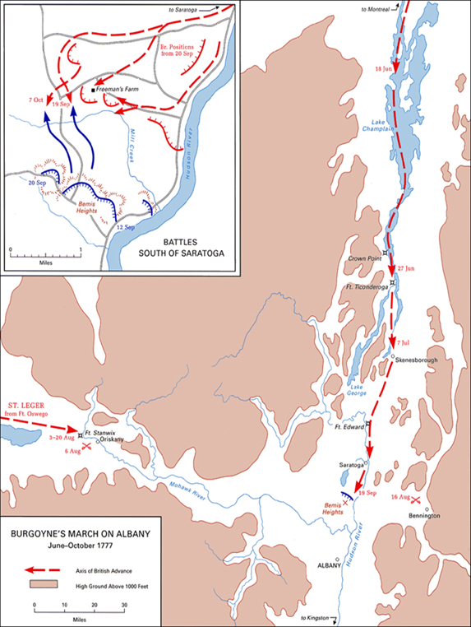
Saratoga
British Gen. Jon Burgoyne surrounded by Continental forces under Gen. Horatio Gates – surrendered army at Saratoga, NY in October 1777
First major American victory and British defeat

Slide 12
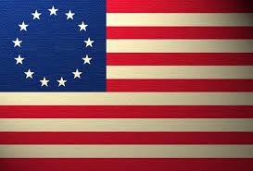



Saratoga
Importance of battle:
British plan to divide colonies failed
And this is HUGE …
Ben Franklin in France trying to win foreign
assistance – victory convinced France and
Spain to join American side
3. Saratoga was the TURNING POINT of the war

Slide 13
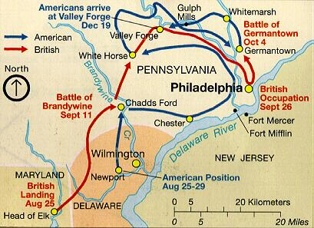
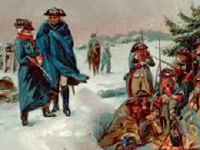
Valley Forge (Not a battle, write info separately in packet)
British captured American capital of Philadelphia
Winter 1777 – Washington’s army camped for 6 months at Valley Forge, PA
Lack of food, clothing, medicine, and shelter – miserable conditions
1/4 of 10,000 troops died during winter

Slide 14
Battle of Guilford Courthouse
March 15, 1781 - Forces under British Gen. Cornwallis suffer heavy losses to the Continental forces of Nathanael Greene at the Battle of Guilford Courthouse, NC. As a result, Cornwallis abandons plans to conquer the backcountry of the Carolinas and retreats to Wilmington, NC. He then begins a campaign to conquer Virginia.

Slide 15
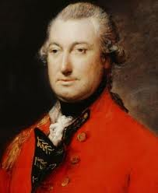
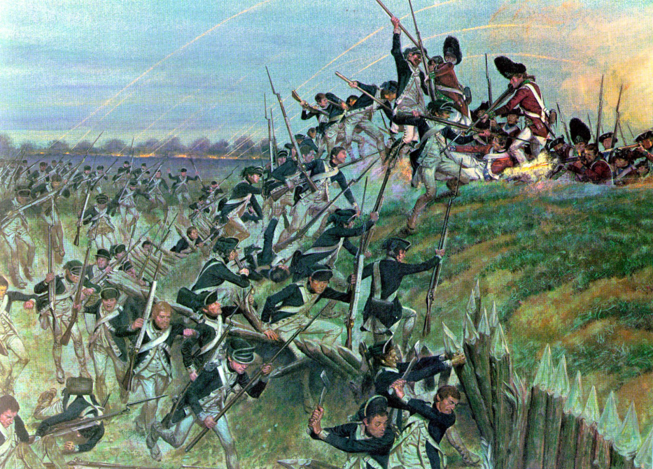
Yorktown
Britain tried to conquer Southern colonies
1781 – British General Cornwallis moved army to Yorktown on VA coast
Wanted port location for support by British navy
Washington moved army south to attack British by land …

Slide 16
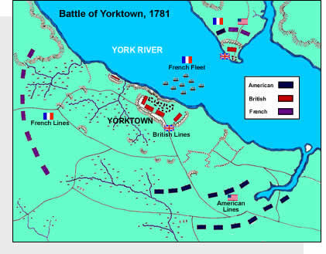
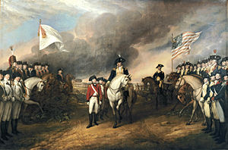
Yorktown
French navy defeated British fleet off VA coast
Cornwallis trapped between American and French armies on land and French navy by sea
October 19, 1781 – Cornwallis and army of 8,000 surrendered to Washington
Last battle between Americans and British. American wins!

Slide 17
Key People (Part 2)
Marquis de Lafayette – French military officer who becomes a trusted advisor to Washington. Will lead colonial troops in siege of Yorktown.
Benedict Arnold – Colonial general who betrays the Patriots, handing over West Point, NY in exchange for a British commission and money. Traitor.
Lord Cornwallis – British general who surrenders to George Washington at Yorktown

Slide 18
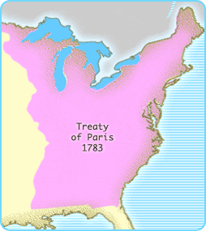
Treaty of Paris - 1783
Britain recognized America’s independence
Set U.S.-Canada border – U.S. reached Mississippi River
American fishermen allowed to fish in Canadian waters
British to leave frontier forts (broken by British)
U.S. to return property to Loyalists (broken by Americans)
British to return escaped slaves in Canada (broken by British)

